Slide 1
CHP - 9 File Structures

Slide 2
INTRODUCTION
In some of the previous chapters, we have discussed representations of and operations on data structures.
These representations and operations are applicable to data items stored in main memory.
However, not always the data is available in main memory.
This is because of two main reasons. First, there may be a program whose size is larger than the available
memory or there may be a program, which requires data that cannot fit in main memory at once.
Second, main memory loses the data once the program is terminated or the power supply is switched off and it may be required to store data from one execution of a program to next.
For these reasons, data should be stored on some external memory. The place that usually holds the data is a file on the disk.

Slide 3
CONCEPTS OF FIELDS, RECGRDS AND FILES
Field: It is a smallest unit to store data, also known as attribute or column. A field has two properties; namely, type and size. Type specifies the data type and size specifies the capacity of the field to store data. For example, address can be of type character with some size in number of characters.
Record: It is a collection of related fields, also known as tuple or row. For example, an employee record may consist of fields Employeeld, Name, Address, City etc.
File: It is a set of related records, also known as relation or table. A file is identified by properties like file name, size and location. File can be text file or binary file. Text file stores numbers as a sequence of characters, whereas, a binary file stores numbers in binary format. A file can contain any number of records. For example, a file containing records of employees in an organization.

Slide 4
CONCEPTS OF FIELDS, RECGRDS AND FILES
File Organization: A file has two facets; logical and physical. A logical file is a set of records, whereas, physical fife shows how records are physically stored on the disk. File organization refers to the physical representation of a file.
Key: It is an attribute that uniquely identifies the records of a file. It contains unique values to which can be used to distinguish one record from another in a file. For example,the field Employee ld can be taken as key for employee file, which can be used to distinguish one record from another.
Page: A file is loaded in the main memory to perform operations like insertion, modification, deletion, etc., on it. If the file is too large in size, it is decomposed into equal size pages, which is the unit of exchange between the disk and the main memory.
Index: It is a pointer to a record in a file, which provides efficient and fast access to records.

Slide 5
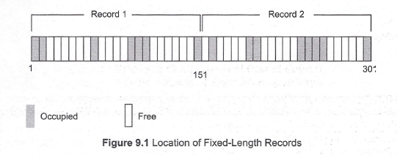
ORGANIZATION OF RECORDS IN FILE
Fixed-Length Records
All the records in a file of fixed-length record are of same length. In a file of fixed-length records, every record consists of same number of fields and size of each field is fixed for every record. It ensures easy location of field values, as their positions are predetermined.
Since each record occupies equal memory, as shown in Figure 9.1, identifying start and end of record is relatively simple.

Slide 6
Fixed-Length Records
A major drawback of fixed-length records is that a lot of memory space is wasted.
Since a record may contain some optional fields and space is reserved for optional fields as well-it stores null value if no value is supplied by the user for that field.
Thus, if certain records do not have values for all the fields, memory space is wasted. In addition,it is difficult to delete a record as deletion of a record leaves blank space in between the two records. To fill up that blank space, all the records following the deleted record need to be shifted.
It is undesirable to shift a large number of records to fill up the space freed by a deleted record, since it requires additional disk access. Alternatively, the space can be reused by placing a new record at the time of insertion of new records, since insertions tend to be more frequent.

Slide 7
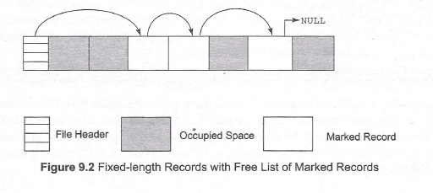
Fixed-Length Records
However, there must be some way to mark the deleted records so that they can be ignored, during the file scan.
In addition to simple marker on deleted record, some additional structure is needed to keep track of free space created by deleted or marked records. Thus, certain number of bytes is reserved in the beginning of the file for a file header.
The file header stores the address of first marked record, which further points to second marked record and so on. As a result, a linked list of marked slot is formed, which is commonly termed as free list.
Figure ,9.2 shows the record of a file with file header pointing to first marked record and so on.

Slide 8

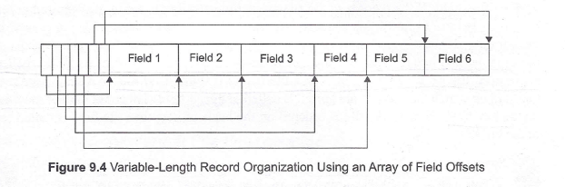
Variable-Length Records
Variable-length records may be used to utilize memory more efficiently. In this approach, the exact length offield is not fixed in advance. Thus, to determine the start and end of each field within the record, special separator characters, which do not appear anywhere within the field value, are required (see Figure 9.3). Locating any field within the record requires scan of record until the field is found.
Alternatively, an array of integer offset could be used to indicate the starting address of fields within a record. The ith element of this array is the starting address of the ith field value relative to the start of the record. An offset to the end of record is also stored in this array, .which is used to recognize the end of last field. The organization is shown in Figure 9.4. For null value, the pointer to starting and end of field is set same. That is, no space is used to represent a null value. This technique is more efficient way to organize the variable-length records. Handling such an offset array is an extra overhead; however, it facilitates direct access to any field of the record.

Slide 9
FILE ORGANIZATION
Arrangement of the records in a file plays a significant role in accessing them. Moreover, proper organization of files on disk helps in accessing the file records efficiently.
There are various methods (known as file organization) of organizing the records in a file while storing a file on disk.
Sequential File Organization
Random File Organization
Indexed Sequential File Organization
Multi-key File Organization and Access Methods

Slide 10
Sequential File Organization
Often, it is required to process the records of a file in the sorted order based on the value of one of its field. If the records of the file are not physically placed in the required order, it consumes time to fulfill this request.
However, if the records of that file are placed in the sorted order based on that field, we would be able to efficiently fulfill this request.
file organization in which records are sorted based on the value of one of its field is called sequential file organization and such a file is called sequential file.
In a sequential file, the field on which the records are sorted is called ordered field.
This field mayor may not be the key field. In case, the file is ordered on the basis of key, then the field is called the ordering key.

Slide 11
Random File Organization
Unlike sequential file, records in this file organization are not stored sequentially.
Instead, each record is mapped to an address on disk on the basis of its key value. One such technique for this mapping of record to an address is called hashing.

Slide 12
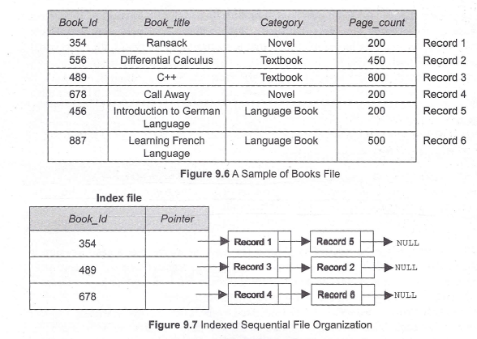
Indexed Sequential File Organization
The indexed sequential file organization provides the benefits of both the sequential and random file organization methods.
Structure of Index File:
index file has two fields-one stores the key value and contains a pointer to the record in the original file.
To understand this, consider the file shown in Figure 9.6, which contains information about the various books. Now if an index is created on the field Book_Id, the index file will be as shown in Figure 9.7.

Slide 13
Multi-key File Organization and Access Methods
So far we have discussed the file organization methods that allow -records to be accessed based on a single key. There might be a situation where it is desirable or even necessary to access the records on anyone of the number of keys.
For example, consider Book file shown in Figure 9.6. Different users may need to access the records of this file in different way. Some users may need accessing the record based on the field Book _Id, others may need accessing the record based on the field Category.
To implement such searches, .the idea of indexing can be generalized and a similar index may be defined on any field of resulting in a multi-key file organization.
There are two main techniques used to implement multi-key file organization, namely, multi-lists and inverted-lists.

Slide 14
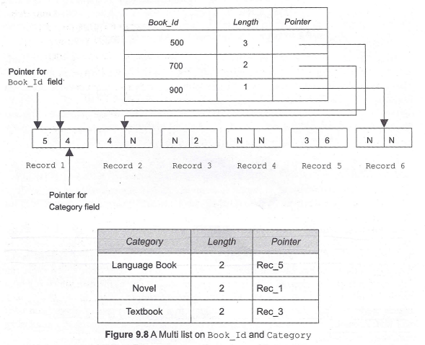
Multi-lists
In a multi-lists organization, indexes are defined on the multiple fields that are frequently used to search the record.
A multi-list structure of the file shown in Figure 9.6 is given in Figure 9.8. Here, one index has been defined on the field Book Id and another on Category.

Slide 15
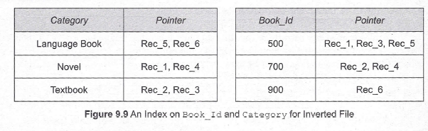
Inverted List
Like multi-lists structure, inverted list structures can also maintain multiple indexes on the file.
The only difference is that instead of maintaining pointers in each record as in multi-lists, indexes in the inverted file maintain multiple pointers to point to the records.
Indexes on Book_ Id and Category field for inverted file are shown in Figure 9.9.

